Slide 1

Event Expenses Calculator
Date: 11-01-2024
By – Rohini S Jadhav

Slide 2
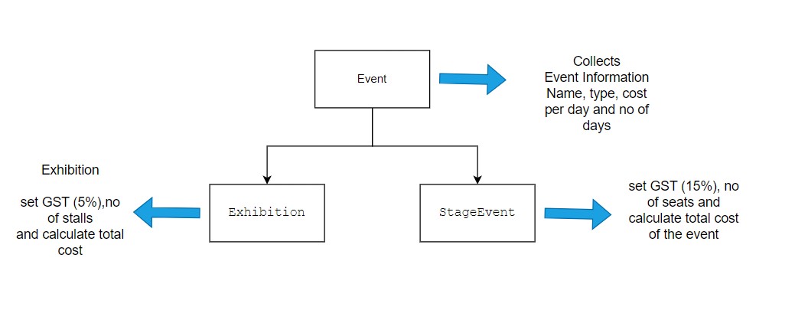
Project Objective
Objective of the project is to calculate the total cost of the events (Exhibition and Stage Event) provided by the user based on the applicable GST

Slide 3
Key Features Used
Inheritance
Parameterized constructors
Access modifiers - private, public, protected
If-else conditions
Super and this keyword
toString() method override

Slide 4
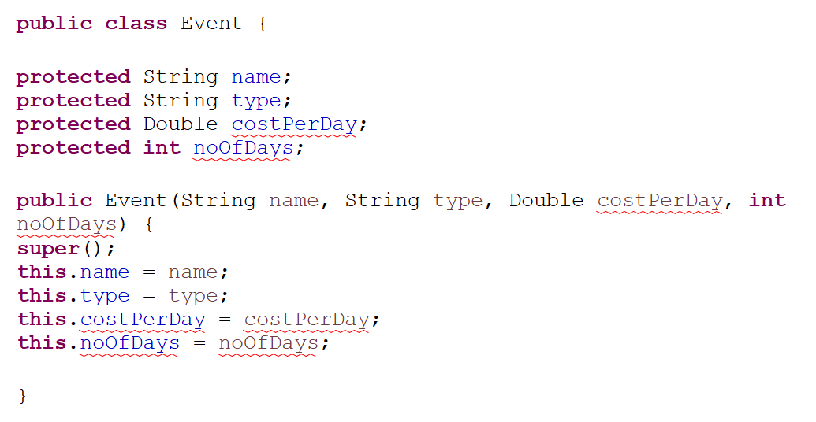
Class Declaration and Initialization
Event Class
Variables – name, type, costperday, noofdays
Access modifier - protected
Parameterized Constructor to initialize the variables

Slide 5
Class Declaration and Initialization
public class Exhibition extends Event {
private static int gst = 5;
private int noOfStalls;
public Exhibition(String name, String type, Double costPerDay, int noOfDays, int noOfStalls) {
super(name, type, costPerDay, noOfDays);
this.noOfStalls = noOfStalls;
}
public class StageEvent extends Event {
private static final int CostPerDay = 0;
private static int gst = 15;
int noOfSeats;
public StageEvent(String name, String type, Double costPerDay, int noOfDays, int noOfSeats) {
super(name, type, costPerDay, noOfDays);
this.noOfSeats = noOfSeats;
}
Exhibition Class
Variables – gst, noofstalls
Access modifier - private
Parameterized Constructor to initialize the variables
Super keyword – this initializes the variables of a parent class invoking parameterized constructor of an Event class
This keyword – refers class level variable
Stage Event Class
Variables – gst, noofseats
Access modifier - private
Parameterized Constructor to initialize the variables
Super keyword - this initializes the variables of a parent class invoking parameterized constructor of an Event class
This keyword - refers class level variable

Slide 6
Execution Flow
Main Class
Accept event name, type, no of days and cost per day from a user by using Scanner class.
Apply condition on a type variable
1 -> Exhibition
2 -> Stage Event
Exhibition ->
ask user to enter no of stalls
event = new Exhibition(name, "Exhibition", costPerday, noOfDays, noOfStalls);
Stage Event ->
ask user to enter no of seats
event = new StageEvent(name, "StageEvent", costPerday, noOfDays, NoOfSeats);

Slide 7

Thank You

